Slide 1
Alumni Event Management System
Submitted By:-
Shreyash Kawane
Sanket Sule

Slide 2
Objective
To develop an effective Web-based Application designed to manage and maintain the all the Alumni Records. Aims to keep an organized and efficient Application that provides the Facility for maintaining good relationship between college and their former Students as Alumni is the backbone of any Educational Institute so the goal of this Application is to manage the database of alumni, manage Alumni meeting schedule and manage the event, also sending the notification message via Email to alumni as notification.

Slide 3
Scope
The Alumni Management System will maintain comprehensive alumni records and engagement with those Students through SMS or by any other Platform. So, Educational Institute will have a Strong network with their Alumni.
Technology used: Core Java, SQL/PLSQL, JDBC, JSP, Spring
MVC
Front-end Technology Used: HTML, CSS and JavaScript etc.
Tools required: Eclipse IDE and MYSQL, etc.

Slide 4
Tables Used
Login:
1.Login:
Sr. no | Fields | Data Type | Size | Constraints
1. | Username | Varchar | 200 | Not Null
2. | Password | Varchar | 200 | Not null, Unique
3. | Contact | Varchar | 200 | Not null, Unique
4. | Email | Varchar | 200 | Not null, Unique
5. | LoginType | Varchar | 200 | Not Null
2.BatchMaster
Sr. no | Fields | Data Type | Size | Constraints
1. | Bid(PK) | int | 5 | Primary Key, Auto Increment
2. | Batch_name | Year | - | Not null

Slide 5
3. AlumniMaster
Sr no. | Fields | Data Type | Size | Constraints
1. | Aid (PK) | Int | 5 | Primary Key Auto Increment
2. | Name | Varchar | 20 | Not Null
3. | Email | Varchar | 20 | Unique
4. | Contact | Varchar | 20 | Unique
5. | Age | Int | 5 | Not Null
6. | Company | varchar | 20 | Not Null
7. | Bid (FK) | Int | 5 | Foreign key on delete cascade on update cascade
5.AttendanceMaster
Sr no | Field | Data Type | Size | Constraints
1. | aid(PK) | int | 5 | Foreign key
2. | eid(PK) | int | 5 | Foreign key
3. | date | date | - | Not null
4. | status | varchar | 20 | Not null

Slide 6
6. EventMaster
Sr no. | Fields | Data Type | Size | Constraints
1. | Eid (PK) | Int | 5 | Primary Key auto increment
2. | name | varchar | 20 | Not Null
3. | date | Date | - | Not Null
4. | Time | varchar | 20 | Not Null
5. | Venue | Varchar | 20 | Not Null
6. | Bid (FK) | Int | 5 | Foreign Key on delete cascade on update cascade
7. | Subject | Varchar | 200 | Not Null

Slide 7
Tables
7.FeedbackMaster
Sr. No | Fields | Data Type | Size | Constraints
1. | details | Varchar | 20 | Not Null
2. | Rating | Int | 5 | Not Null
3. | Eid | Int | 5 | Foreign Key on delete cascade on update cascade
4. | Aid | Int | 5 | Foreign Key on delete cascade on update cascade

Slide 8
8.Alumni-Batch Join
Sr no. | Fields | Data Type | Size | Constraints
1. | Aid | Int | 5 | Foreign Key on delete on Update cascade
2. | Bid | Int | 5 | Foreign Key on delete on Update cascade

Slide 9
Classes Required
Controller
Model
Service
Repository

Slide 10
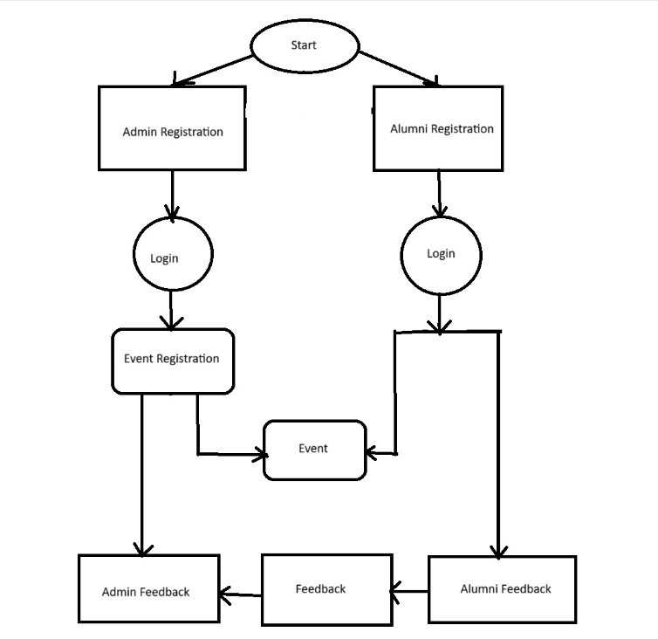
Flow Diagram

Slide 11
THANK YOU…. !

